Slide 1

Car Sales Predictions
Lachandra Ash
11/15/2022

Slide 2

Car sales History
Although the Germans and the French had the honor of inventing and perfecting the vehicle, it was the Americans who would go on to dominate the industry for the better part of the twentieth century.
By the 1920s, Ford, General Motors, and Chrysler had established themselves as the three major automakers, thanks in large part to the mass manufacturing methods pioneered by Henry Ford.
When the war ended, manufacturing of automobiles in Europe and Japan went through the roof to satisfy surging demand

Slide 3
The Problem
The used car dealerships want to increase the sales of their used cars.
The dealers want to predict their sales to increase their revenues for future sales.
Used car dealers deal with challenges when obtaining consumers.

Slide 4

Target Price in Thousands Variable
Prices of the Vehicles
Varying qualities and features makes the vehicles more expensive.
The vehicle's value determines the price of the vehicle.

Slide 5
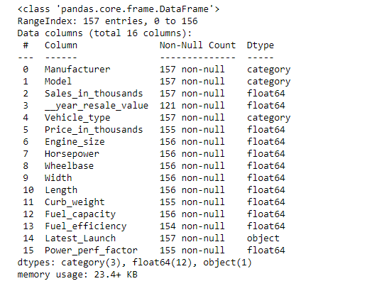
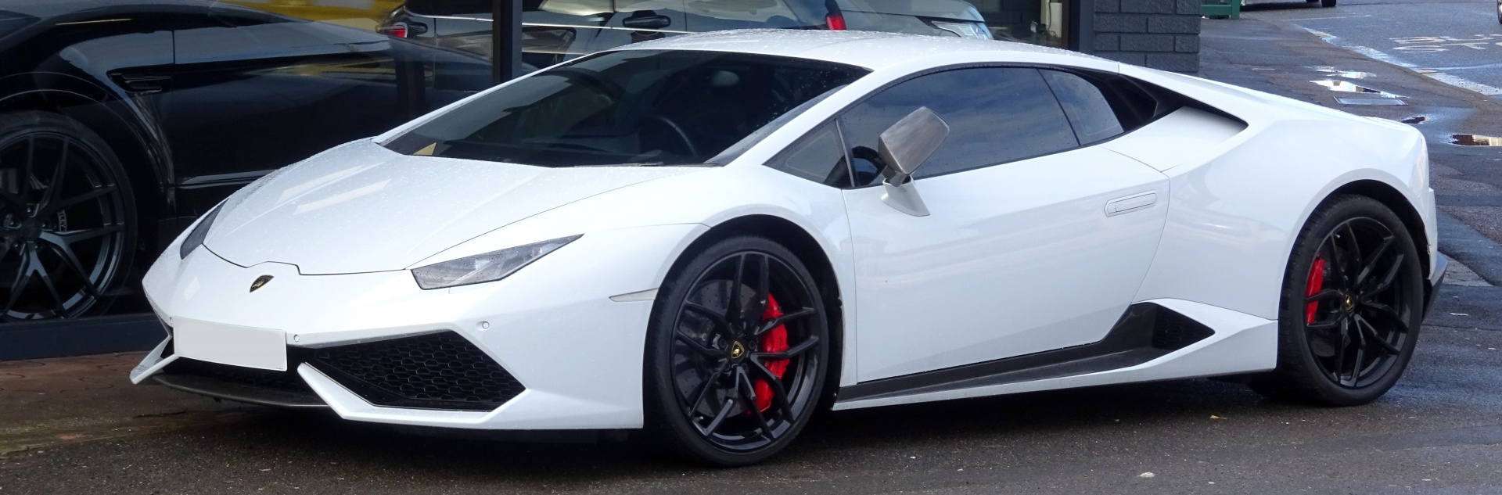
Car Sales Dataset

Slide 6
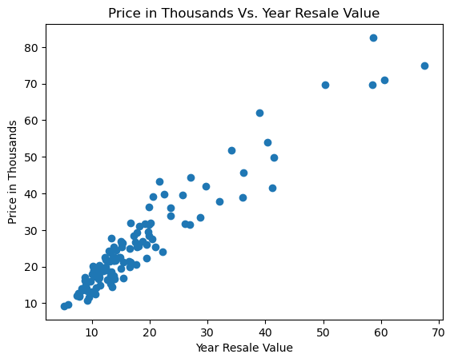
Price in thousands vs. year resale value
The year resale value increased in price by the thousands as the year resale value increased.

Slide 7

Manufacturer Vs. Price in thousands
Price increased among the various types of manufacturers.

Slide 8
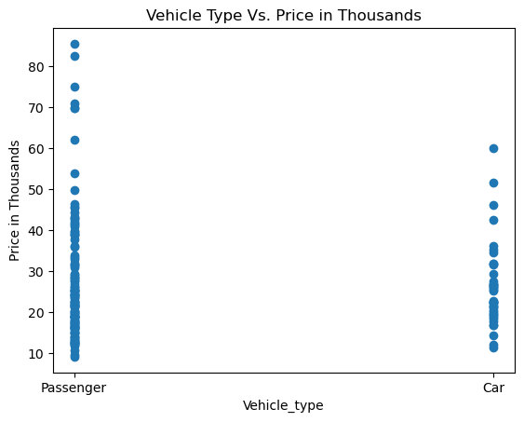
Vehicle Types Vs. Price in Thousands
There are more passenger vehicles versus cars.

Slide 9
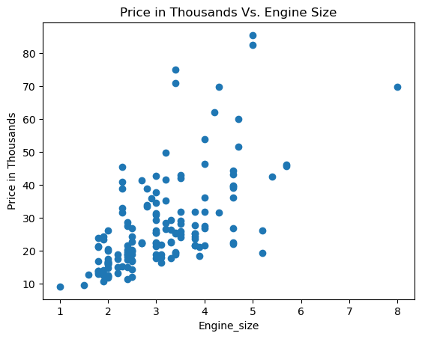
Price in the thousands Vs. engine size
The bigger the engine size the more expensive the car.
Vehicles with engine sizes greater than 5 experienced a price drop.
There were no vehicles that had engine sizes between 6-8.

Slide 10
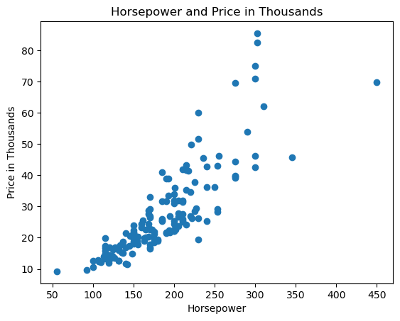
Horsepower and Price in Thousands
The more horsepower that a vehicle has, the more expensive it is.

Slide 11
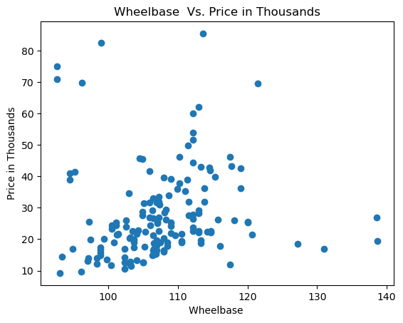
Wheelbase Vs. price in thousands
The wheelbase sizes approximately between 100-115 were more expensive versus the wheelbase sizes from 115-140.

Slide 12
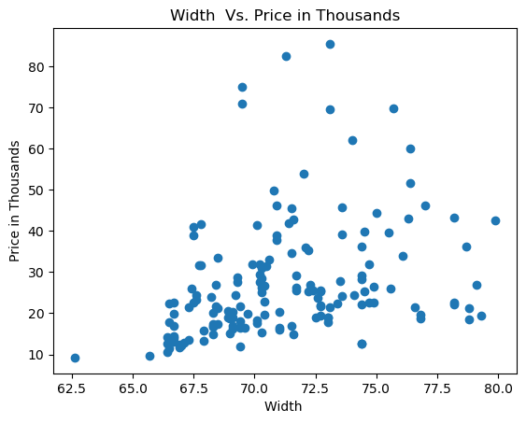
Width vs. price in thousands
The greater the width of the wheelbase, the more expensive it is..

Slide 13
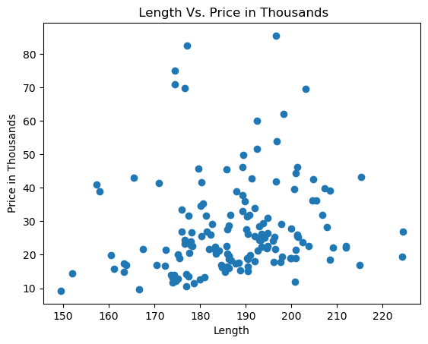
Length Vs. price in thousands
The greater the length of the wheelbase, the more expensive it is.
After the length of 20, the prices dropped.

Slide 14
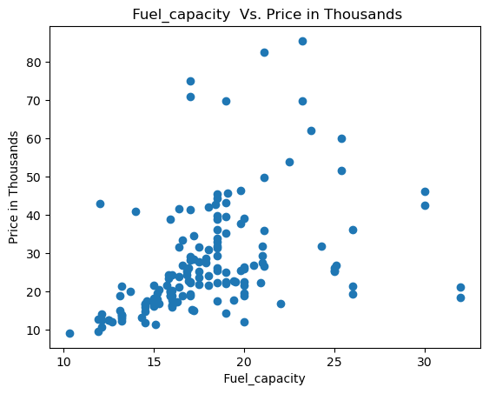
Fuel capacity vs. price in thousands
The vehicles with greater fuel capacity were more expensive.

Slide 15
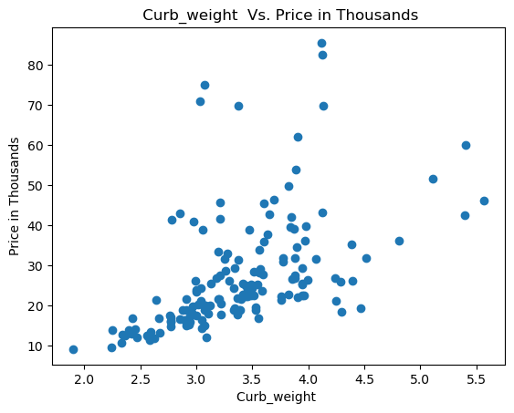
Curb weight vs. price in thousands
As the curb weight increased, the price increased.

Slide 16
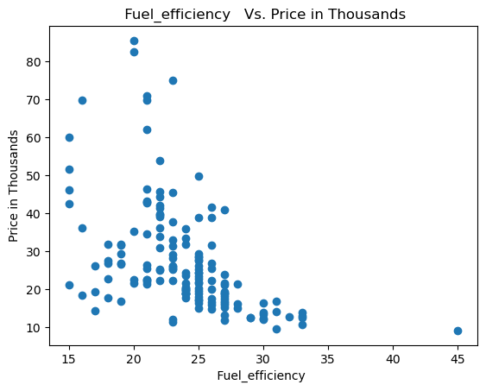
Fuel Efficiency vs. price in thousands
The vehicles with greater fuel efficiency were more expensive till approximately 23, then the price began to decline from 23 to 45.

Slide 17
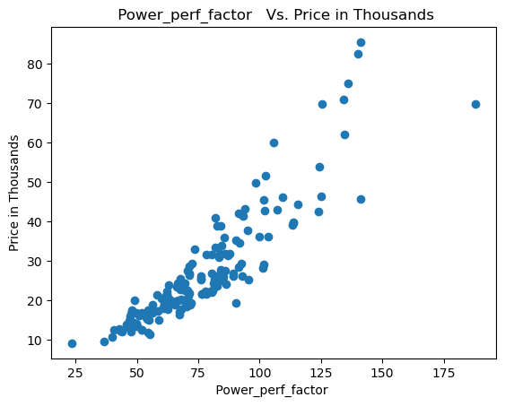
Power perfect factor vs. price in thousands
The higher the vehicle’s power perfection factor is, the higher the price of the vehicle.

Slide 18
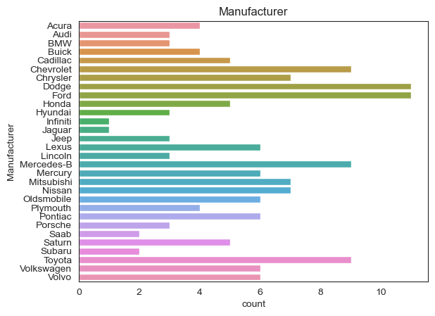
Manufacturer
Dodge and Ford had the highest number of vehicles. Chevrolet, Mercedes-Benz, and Toyota had the second highest number of vehicles.
Infiniti and Jaguar have the least number of vehicles.

Slide 19
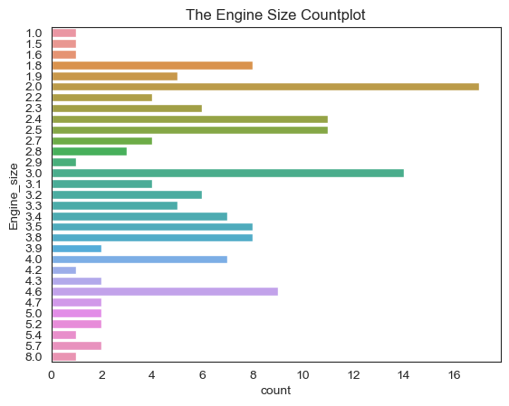
Engine size
The 2.0 engine size has the greater number of engines of that size.
The 3.0 engine size has the second greatest number of engines of that size.

Slide 20
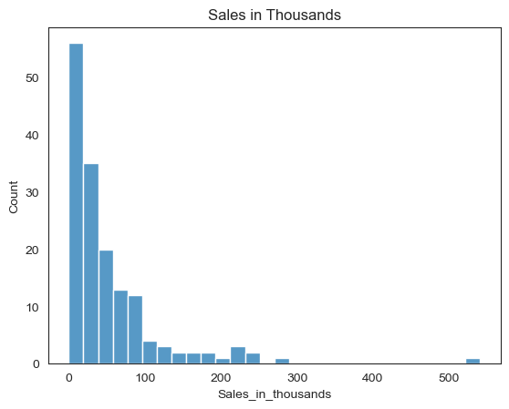
Sales in thousands
The number of vehicle sales are greater in the beginning of the sales, but as the sales decreased, the number of sales decreased.

Slide 21
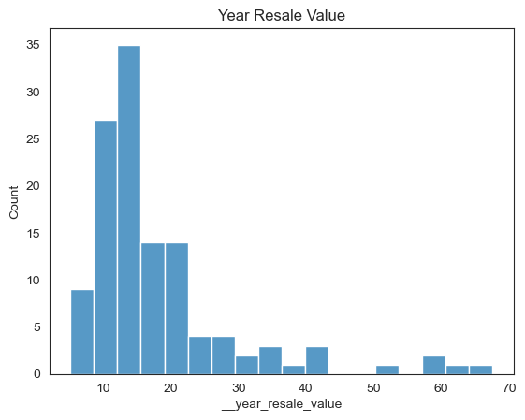
Year Resale value
The vehicle year resale value was greater between 10-15 years of age.
After 15 years of vehicle age, the resale value begins to decrease.

Slide 22
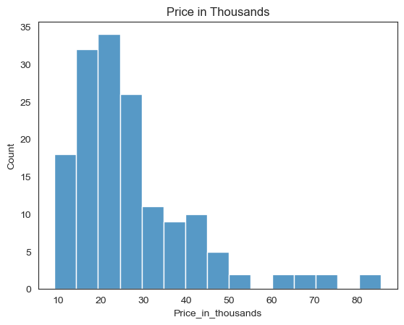
Price in thousands
The prices between 15,000 to 30,000 had the highest number of vehicles.

Slide 23
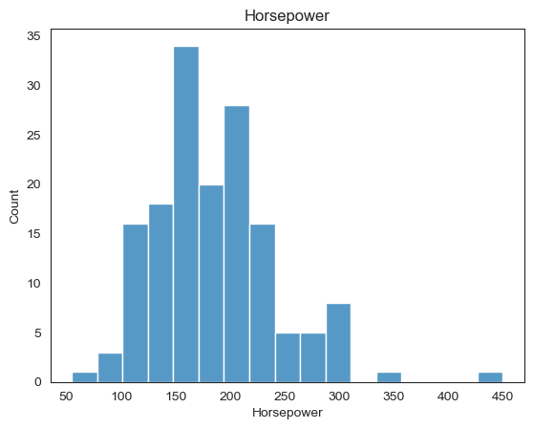
Horsepower
The engines with 150 and 200 horsepower have the greatest number of vehicles with the same number of vehicles.
The engines with 50, 100, 350, and close to 450 horsepower has the least number of vehicles with that horsepower.

Slide 24
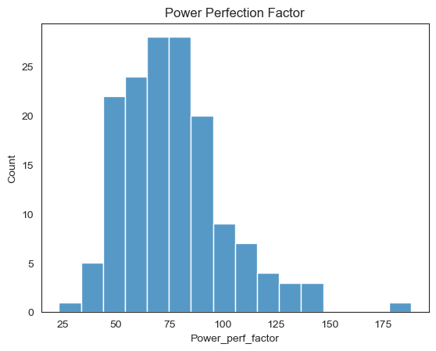
Power Perfection Factor
The power perfection factor with the greatest number of vehicles was approximately 75.
The power perfection factor with the least number of vehicles was approximately 25 and approximately more than 175.

Slide 25
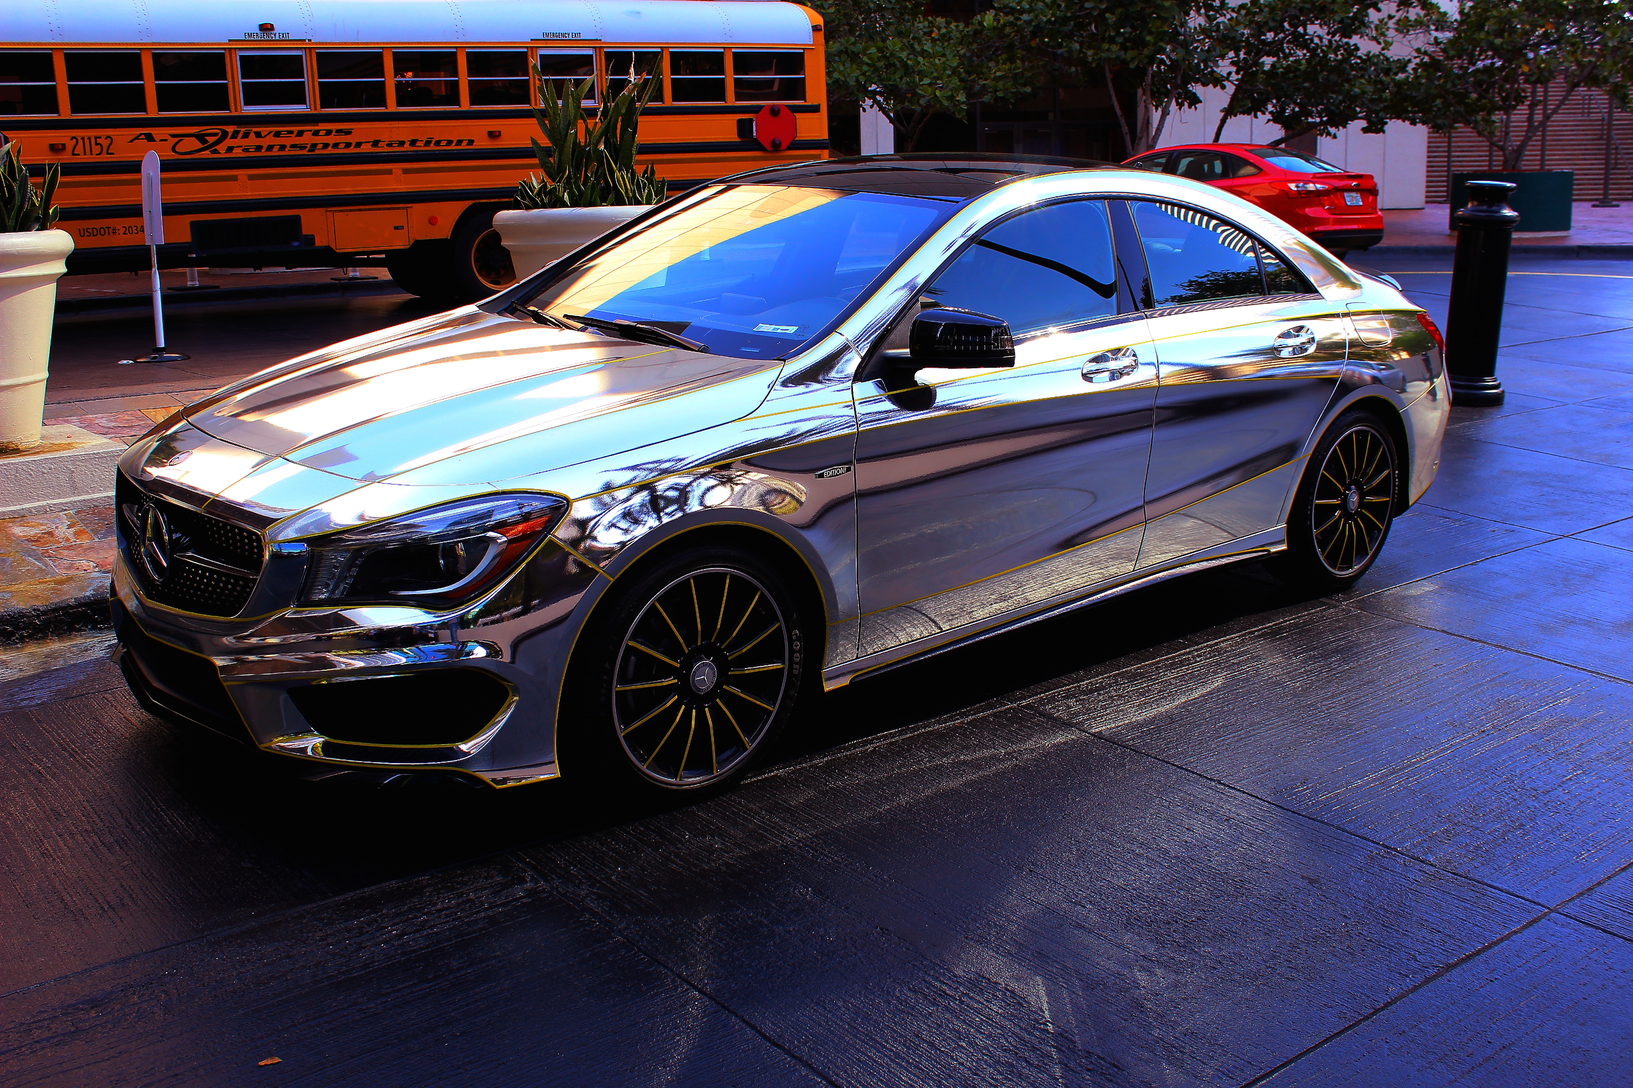
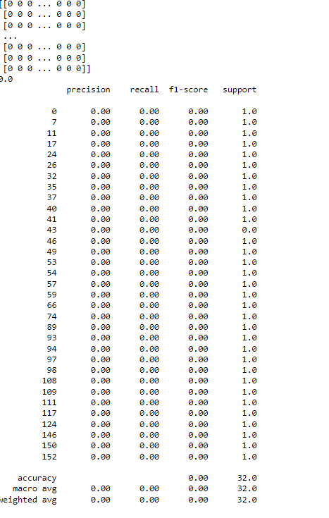
The Naïve Bayes Model
The Naïve Bayes model resulted in 0 accuracy after many tries.

Slide 26
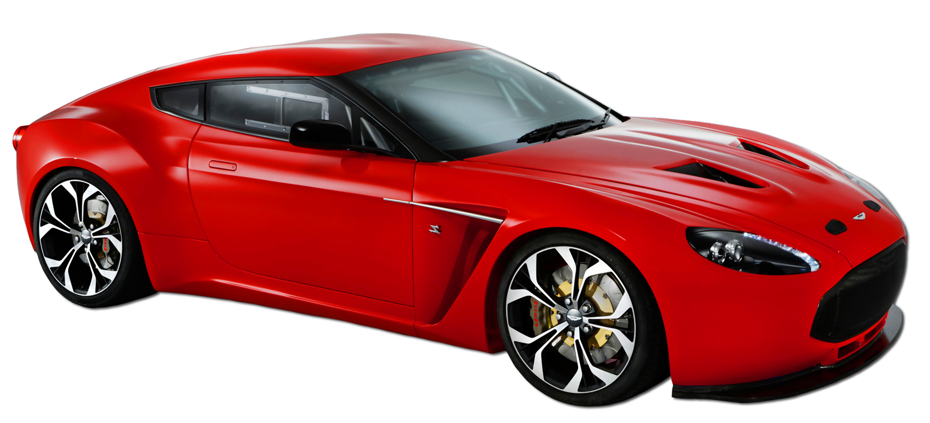
Conclusion
Used car dealerships can increase their sales by dealing with high quality vehicles with good year resale value.
The engine size causes the vehicle to be more expensive.
The vehicles with horsepower between 100-200 were priced between $15,000 – $40.000.
I did a lot of research on this data set, and it did not have enough explanation for the dataset.
I was still interested in exploring the dataset.

Slide 27

Thank You

